Slide 1



TEAM : ECOEARNING ENTHUSIAST
PREDICTION OF SOLAR POWER GENERATION BASED ON WEATHER FORECAST
JULIAN GRAF
AMRUTHA M
ANSIKA BABU
3 MSc DataScience
Department of Statistics and Data Science

Slide 2
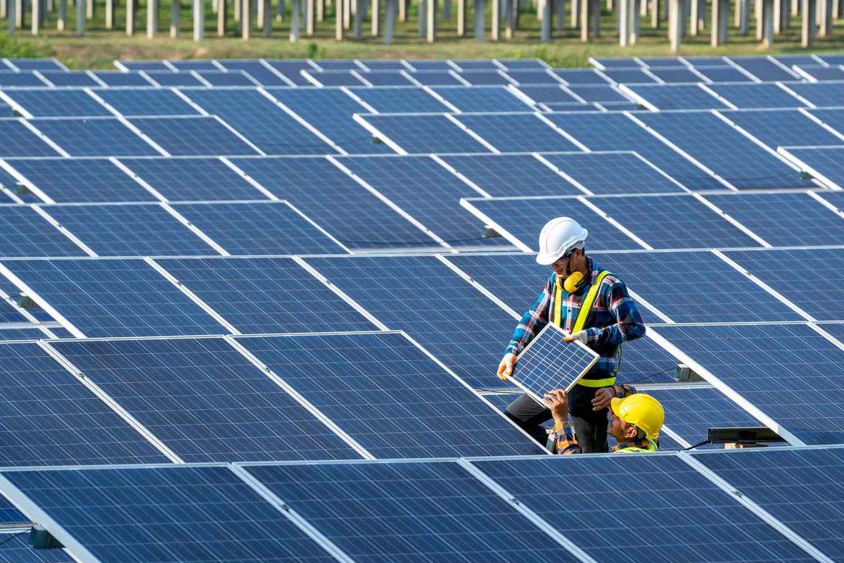




Government Incentives
long-term savings
minimal maintenance
low operating
BENEFITS

Slide 3

CHALLENGES
It's important to note that the cost competitiveness of solar energy varies by region and market conditions. While solar energy has become cheaper in many places, there are still areas where traditional energy sources may appear more cost-effective due to factors like subsidies, legacy infrastructure, weather or energy policies. However, the global trend indicates that solar energy's cost advantage is growing, and as technology continues to improve and economies of scale are realized, solar energy is expected to become an even more affordable and widespread energy source.

Slide 4

A fresh approach to the concept
Many countries and regions have implemented policies and regulations that allow individuals and businesses to sell excess power generated from solar panels back to the electricity grid. This process is commonly referred to as "net metering" or "feed-in tariff" (FiT) programs.
This rate is often higher than the retail price of electricity, providing an incentive for people to invest in renewable energy systems.
Hence, we propose this project to encourage people to use solar pannels by helping them figure out how much energy would be generated if they impant solar panels in their region. The information would be collected using geolocation and then model building will happen.

Slide 5

Problem Statement
Addressing the Solar Savings Blindspot:
Our objective is to combat the lack of awareness among homeowners about the substantial financial benefits attainable through the installation of solar panels. By highlighting the potential for significant cost savings and even earnings, we aim to bridge the information gap and encourage wider adoption of solar energy solutions, paving the way for a more sustainable and economically advantageous future for everyone.

Slide 6

FEATURES
GPS Location
Retrieval
Weather Data
Retrieval
Prediction and Visualization
Solar Panel
Specifications

Slide 7
PROCESS INVOLVED
1. Project Planning:
The scope of the project is to encourage use of renewable energy and to develop a website to estimate the savings we can gain by using solar panels. This project would predict the average power generated in a particular region by analysing the weather and climate of that region.
2. Data Collection and Preprocessing:
We use an online dataset to train the model, that is, train the model to estimate the power generation using temperature, humidity, sky cover, pressure, wind speed and various other factors.

Slide 8
3. Feature Engineering and Selection:
We then create a heatmap to analyze the correlation among attributes. and remove those attributes which are not necessary.
4. Model Selection and Training:
We used various machine learning algorithms to compare the accuracy and find the best fit model.
5. Real-Time Weather Data Integration:
We incorporated an API to fetch real-time weather forecast data.using services like OpenWeatherMap or a custom API.
6. Prediction Generation and Display:
We Implemented the prediction algorithm in the back-end of the website and displayed real-time solar power predictions.

Slide 9

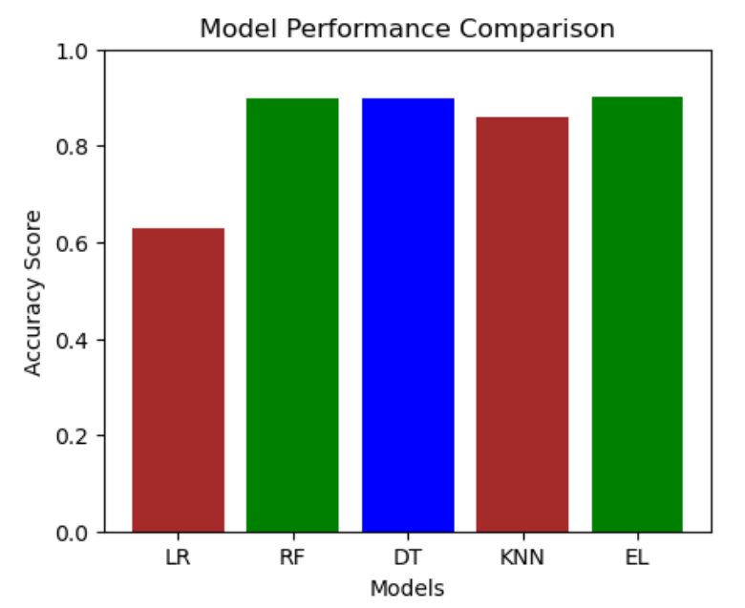
PERFORMANCE COMPARISON

Slide 10
